Slide 1
Spring Cloud Config
Building a Centralized Configuration Server

Slide 2

Notes:
Briefly discuss that although the workhorse continues to be the relational model, NoSQL has its uses and we need to know now to query these systems.

Slide 3
Objective
By the end of this 20 minute session you will be able to write a configuration server using the spring-cloud-config-server dependency that consumes configuration settings from a GitHub repo and you will be able to set up a client application to consume those properties from the config server.

Slide 4
Needs / Benefits
External Configuration Key to 12 Factor App
Disposable Microservices pick up config when a new instance is created
Config can be changed by simply changing files or values in a single git repo

Slide 5
Creating Config Server
Configuring App to Be a Config Client

Slide 6
Create Spring Config Server

Slide 7
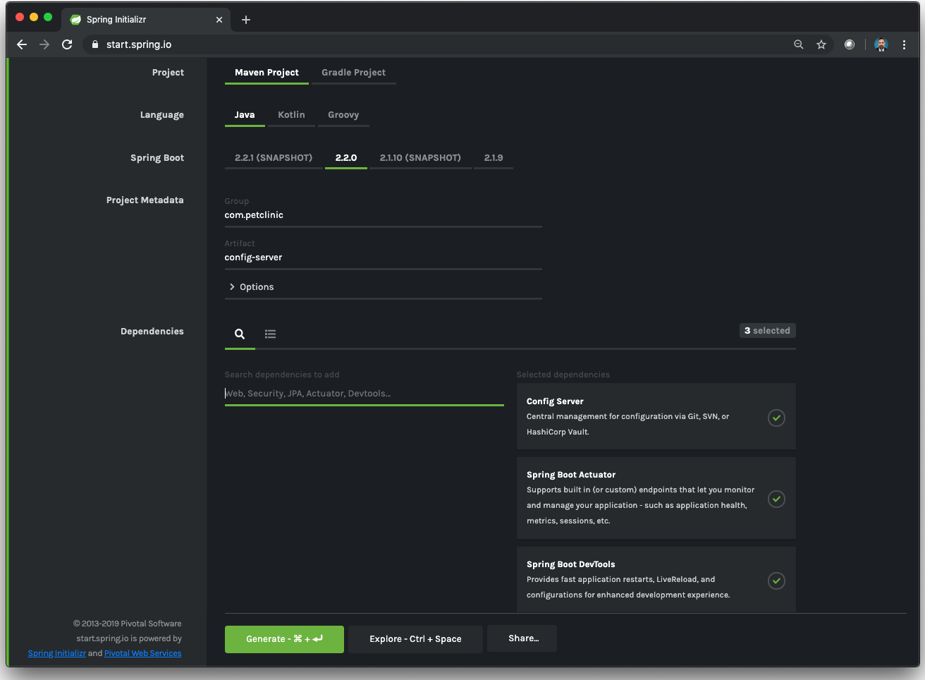
Add Config Server Dependency

Slide 8
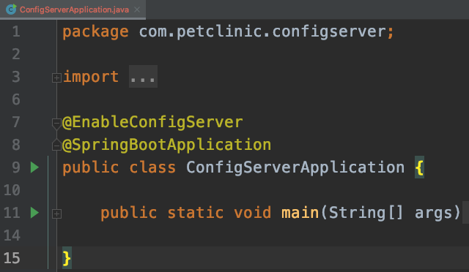
Add @EnableConfigServer annotation to application class
Notes:
This will automatically expose endpoints that return the application properties from each

Slide 9
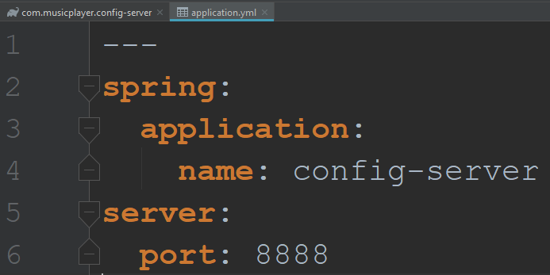
Change application.properties to application.yml and add app name and server port
Notes:
PCF needs a yml file so we will make that change now.

Slide 10
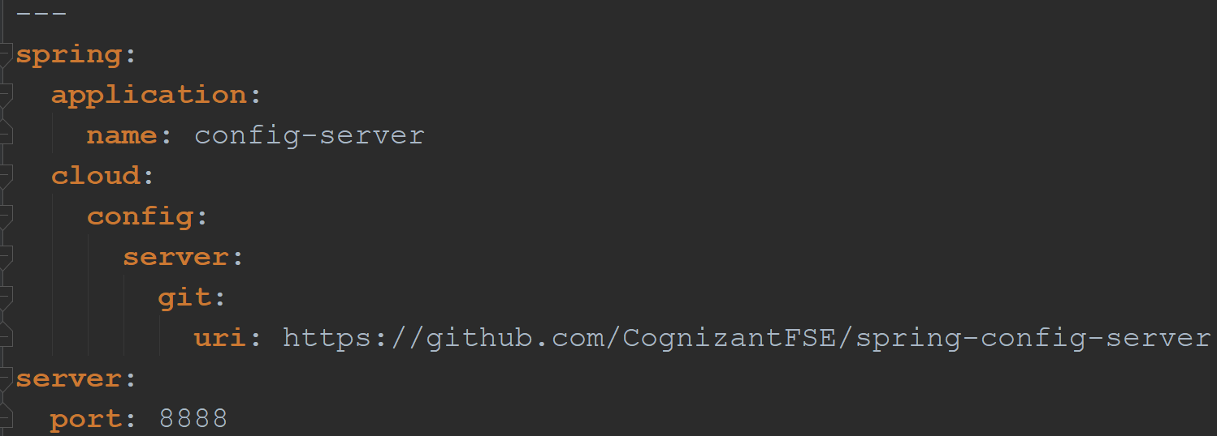
Add cloud config server git uri

Slide 11
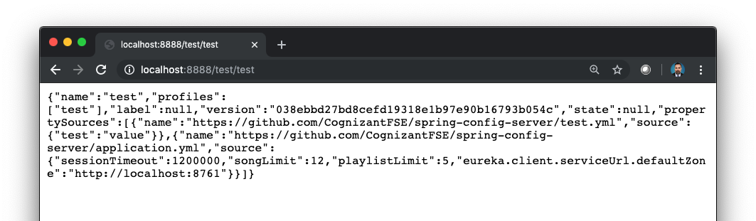
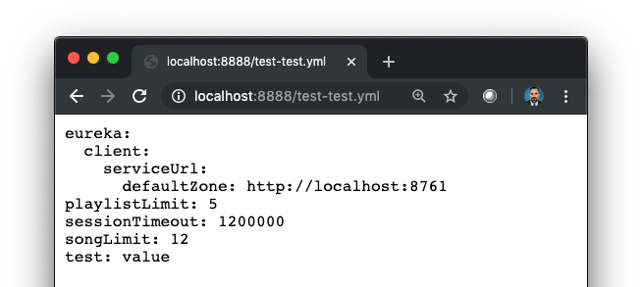
5 Path Variations
/ {application} / {profile} [/{label}]
1
/ {application} - {profile}.yml
2
{Application} = Spring Client Application Name
{label} = Git Branch {profile} = Spring App Active Profile

Slide 12
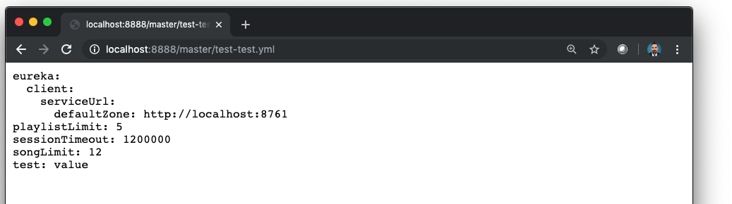
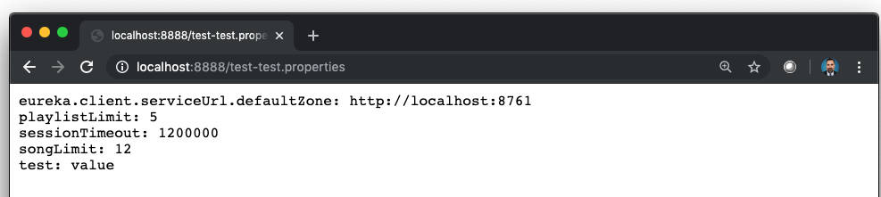
5 Path Variations
/ {label} / {application} - {profile}.yml
3
/ {application} - {profile}.properties
4
{Application} = Spring Client Application Name
{label} = Git Branch {profile} = Spring App Active Profile
Notes:
Because there is no matching file with application name “anything” and profile name “anything”, config server serves up the default properties file which is in the root of the repo.

Slide 13

5 Path Variations
/ {label} / {application} - {profile}.properties
5
Along with test.yml, application.yml gets picked up in all of these scenarios as it is the default
{Application} = Spring Client Application Name
{label} = Git Branch {profile} = Spring App Active Profile
Notes:
Because there is no matching file with application name “anything” and profile name “anything”, config server serves up the default properties file which is in the root of the repo.

Slide 14
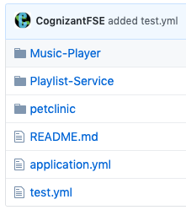
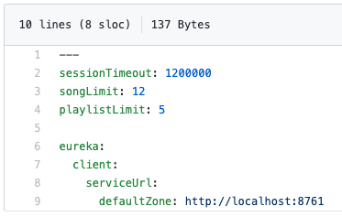

Git Repo Contents
Root Folder
application.yml
petclinic Folder
owner-service.yml

Slide 15
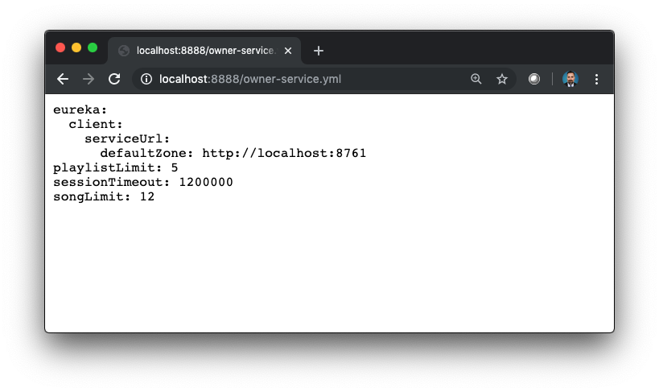
Petclinic folder not being accessed
Owner-service.yml values not showing up

Slide 16
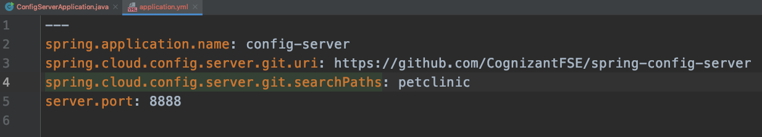
Add searchPaths to Config-Server application.yml to access petclinic folder
*restart config-server app

Slide 17
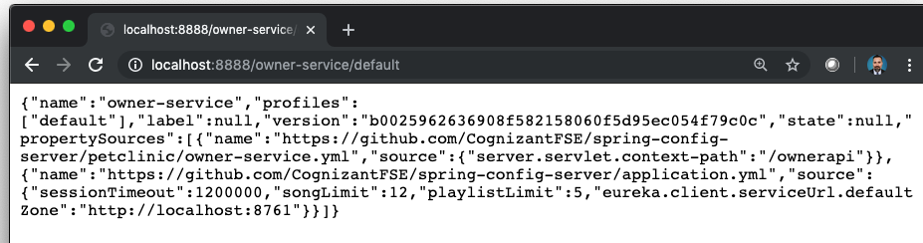
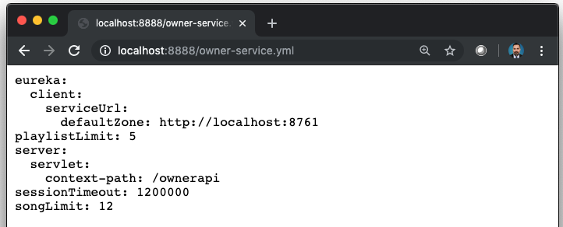
Owner-service.properties contents show up
Note that the application.properties are still in the response
Notes:
This slide illustrates the fact that you can have global configurations in the root and then application-specific properties nested in folder structures

Slide 18
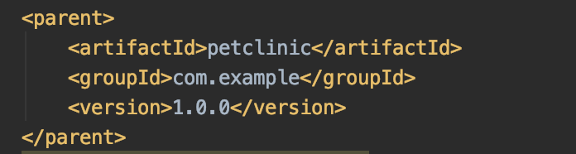
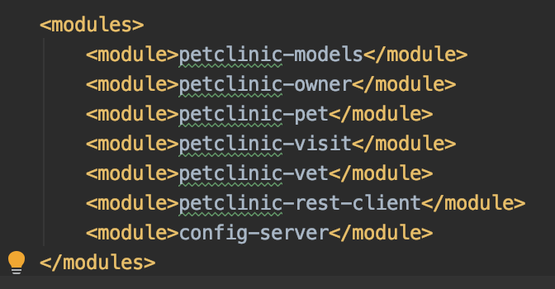
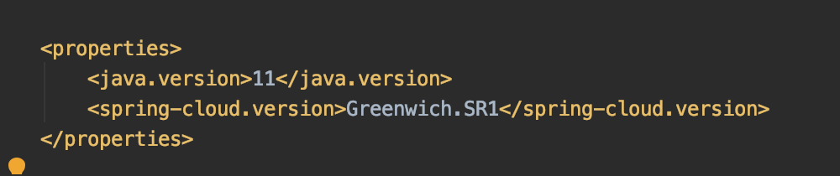
To Add Config-Server to petclinic base project:
In config-server pom.xml
In pet-clinic pom.xml

Slide 19
Config Client

Slide 20
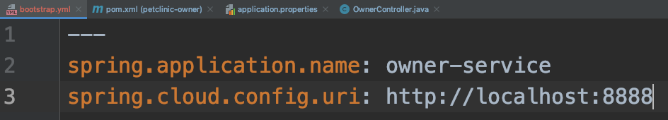
In Client Application (using petclinic-owner from https://github.com/Cognizant-FSE/petclinic-phase6)
Create a file in resources folder called bootstrap.properties or bootstrap.yml
Add spring.application.name
Set to name of properties file
Add spring.cloud.config.uri
Set to config-server address
Local for now
Notes:
Now might be the time to mention that you can also add –dev or –prod to the properties filename in Github and set the spring.application.profile to whichever property file it should consume.

Slide 21
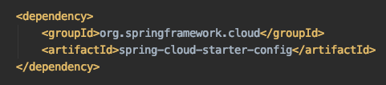
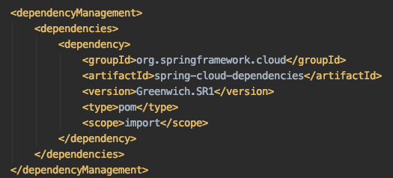
Add spring-cloud-services-starter-config to pom.xml
This may need to be adjusted to suit your application.
Notes:
I would mention that it is sometimes easier to generate a spring project with the appropriate dependencies and copy the gradle.

Slide 22
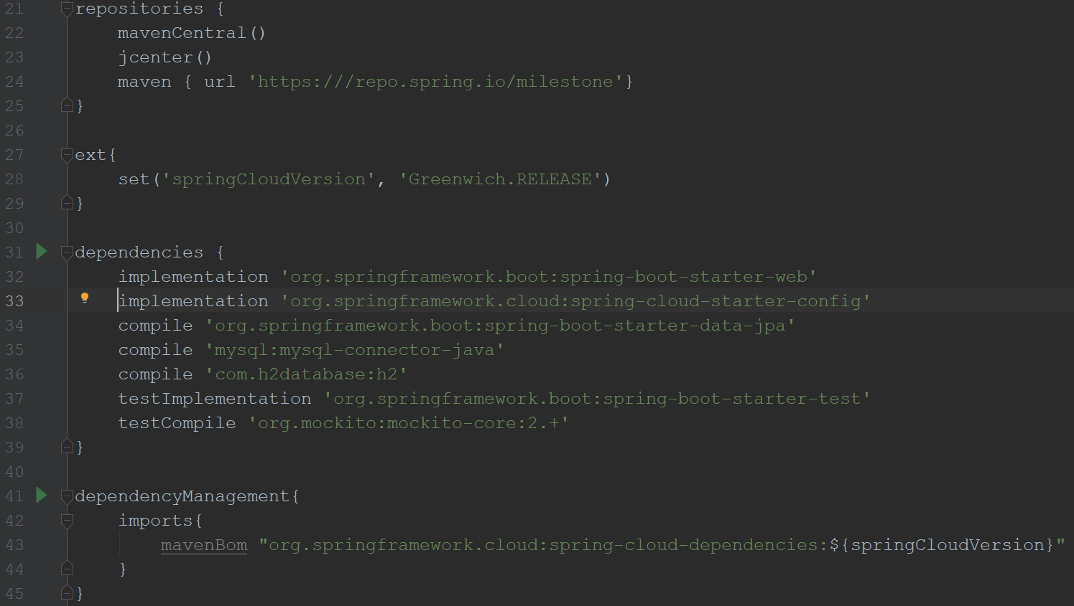
If using Gradle…
This whole section
Notes:
I would mention that it is sometimes easier to generate a spring project with the appropriate dependencies and copy the gradle.

Slide 23


Using Owner-Service from Petclinic Project
Comment out server.servlet.context-path in application.properties
Run application to see it pic up config from config-server
It worked!
Notes:
There is another way to retrieve these settings using @ConfigurationProperties annotation on a class with fields matching the names, but I could not get this method to work using any of the tutorials I came across and gave up on it.

Slide 24
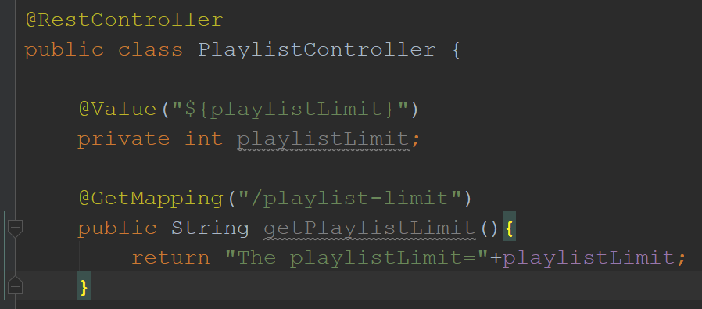
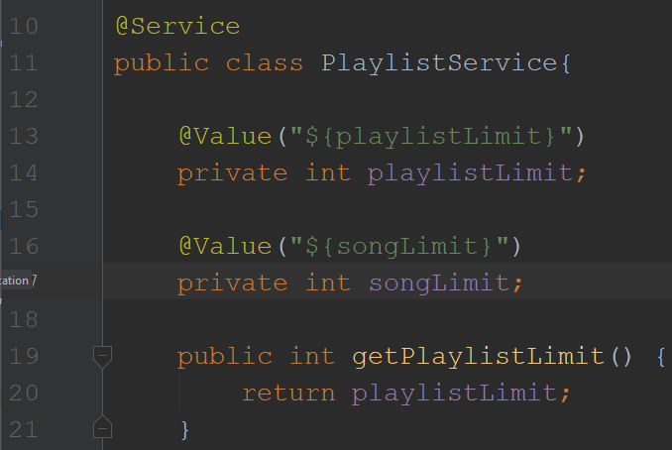
Retrieve Config in Code Base
@Value(“${ name-of-property }”)
Name-of-property must match property name in git repo file
Other traditional mechanisms:
@ConfigurationProperties
Environment abstraction
Notes:
There is another way to retrieve these settings using @ConfigurationProperties annotation on a class with fields matching the names, but I could not get this method to work using any of the tutorials I came across and gave up on it.

Slide 25
Review

Slide 26
Review
Config Server
spring-cloud-config-server dependency
@EnableConfigServer over Main class
spring.cloud.config.server.git.uri set to address
5 pathway options
Add searchPaths for nested properties in git repo

Slide 27
Review
Config Client
spring.application.name in bootstrap.yml
spring.cloud.config.uri in bootstrap.yml
spring-cloud-services-starter-config-client dependency
@Value(“${ name-of-property }”) above property in Controller or Service

Slide 28
Objective
By the end of this 20 minute session you will be able to write a configuration server using the spring-cloud-config-server dependency that consumes configuration settings from a GitHub repo and you will be able to set up a client application to consume those properties from the config server.

Slide 29
Knowledge Check
What 3 things must you do to create a config server?
What 3 things must you do to turn a Springboot app into a config client?
Are properties applied automatically? How else can you retrieve the values?
Notes:
See if they have their projects working

Slide 30
What kinds of properties would you place in a git repo?
What are the advantages to centralized config?

Slide 31
Thank you
Jason Monroe (688776)

